Slide 1
Problems facing marine habitat
Student’s Name
Institutional Affiliation
Date

Slide 2
Introduction
Did you know that around 70% of the earth's surface is covered by water? Did you know that this water acts as a habitat for about one million organisms? Starting from the biggest mammal on earth (whale) to the tiniest organisms, the ocean is a home for uncountable organisms.
Yet, this home to millions of organisms has been facing problems in the past.
Organisms living in oceans face serious challenges as a result of human action. Some of these actions threaten their extinction.
Some of the problems include insufficient food and oxygen, pollution, and ocean acidification.

Slide 3
Insufficient food and oxygen
One of the biggest challenges for marine organisms is insufficient food and oxygen.
Except in the shallow areas where there is sufficient light where there is enough light to allow photosynthesis at the bottom, most marine organisms live deep in the water where light cannot penetrate.
With the increasing depth, the amount of material reaching the bottom decreases. Food at the bottom is therefore limited (Rhoads et al.,1978).
Many benthic organisms have limited mobility and mainly rely on the water above them to supply food. Deep in the sea, there is little current that supplies oxygen.
Organisms respire and use up the available oxygen, which leaves sediments anoxic, becoming inhabitable for most species (Poore & Wilson, 1993).
Although organisms that live near the water enjoy plenty of food and oxygen, they are more vulnerable to predators.

Slide 4
Ocean acidification
The other problem facing marine life is ocean acidification. Oceans absorb a lot of carbon dioxide from the atmosphere.
Due to the increased CO2 from human processes like burning fossils, industrialization, and deforestation, the oceans are absorbing too much of it, which has made the ocean PH fall.
The ocean's PH balance is dropping to the point where some life within the oceans is having trouble coping.
The PH as of 2020 was 8.1, and it is estimated to fall to 7.8 by the end of the century (NOAA).

Slide 5
Pollution
The last problem is pollution. Ocean pollution disturbs marine life making their life inhospitable.
For example, the "Great Pacific Garbage Patch" in the Pacific Ocean is worrying and disturbing marine life (Lebreton et al., 2018).
Ocean pollution comes from pesticides, industrial waste, domestic waste, manufactured chemicals, mercury, plastic waste and oil spills.
It is estimated that more than 10 million tons of plastic enter the ocean every year.
Ocean pollution makes life difficult for marine life and leads to the death of such organisms.

Slide 6
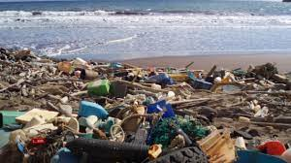
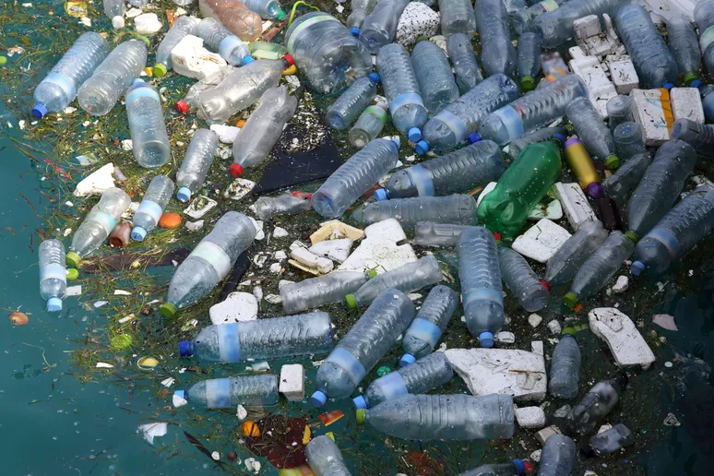
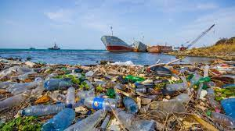
Ocean pollution showing plastic pollution

Slide 7
Conclusion
In conclusion, marine habitats are home to millions of organisms, both small and large.
However, this habitat is facing severe challenges that threaten the life of marine life.
Most of these problems are caused by human action. Some of the problems that marine organisms face include insufficient food and oxygen, pollution, and acidification.
Humans need to preserve and protect oceans because they are home to many organisms.

Slide 8
References
Lebreton, L., Slat, B., Ferrari, F., Sainte-Rose, B., Aitken, J., Marthouse, R., ... & Reisser, J. (2018). Evidence that the Great Pacific Garbage Patch is rapidly accumulating plastic. Scientific reports, 8(1), 1-15.
Poore, G. C., & Wilson, G. D. (1993). Marine species richness. Nature, 361(6413), 597-598.
Rhoads, D. C., McCall, P. L., & Yingst, J. Y. (1978). Disturbance and Production on the Estuarine Seafloor: Dredge-spoil disposal in estuaries such as Long Island Sound can be managed in ways that enhance productivity rather than diminish it. American Scientist, 66(5), 577-586.

